Slide 1
Youth Protection Guidelines by Carol Wisdom

Slide 3
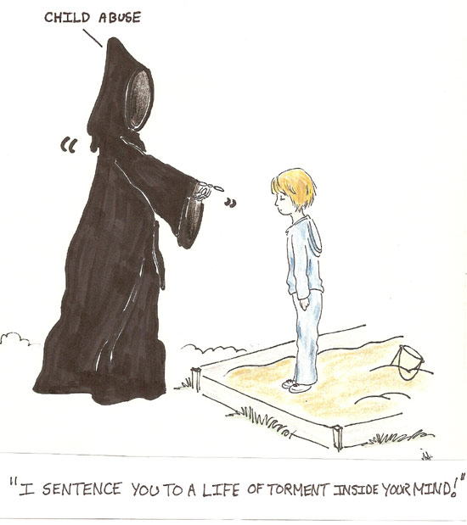

Slide 4
Education: Every Kiwanis club is expected to inform and educate its members on these guidelines, best practices, and inform them to do when they become aware of youth in potentially harmful situations. Every member must be provided a copy of these guidelines and receive educational training annually.

Slide 5
Chaperone: A chaperone is defined as a Kiwanis member, faculty member, parent, legal guardian, or person who is in loco parentis, twenty-one (21) years of age or older, that has been approved by the school or agency and registered with the school or agency to accompany the youth members at the specific event.
One for ten rule:

Slide 6
Background Checks
Criminal history background checks may be required for all adults working with youth.
In the absence of any other requirement to do so, Kiwanis clubs are required to have a clear background check, by any provider, of any member serving as advisor to any Service Leadership Program club, program or activity.
Approved background checks shall be valid for no more than ten years.
Kiwanis International requires clear background checks conducted by its provider for all adults working with youth at all Kiwanis International-sponsored events. These include the Key Club International Convention, the Key Club Governor and Administrator training conference, and the Key Club International Leadership Conference, and any Key Leader weekend

Slide 7
Transportation: Adults transporting youth in a vehicle should do so with a second adult in the vehicle. If a second adult is not available the “rule of threes’ is recommended: at least three people in the car at all times. All transportation decisions should be made in accordance with local laws and school policies.

Slide 8
Medications: The possession of prescription and non prescription medications by youth at a Kiwanis event should be permitted only by the written permission of the parent/guardian.

Slide 9
Use of Alcoholic Beverages and Tobacco: While attending any Kiwanis event that is produced primarily by or for the benefit of youth, adults are expected to refrain from consumption of alcoholic beverages and/or use of tobacco products during any portion of the event.

Slide 10
. Reporting: If a Kiwanian observes troubling behavior involving a youth at a Kiwanis event or becomes aware of a situation that is illegal or potentially unsafe for a young person at a Kiwanis event, he or she must immediately contact the appropriate personnel at the event as well as provide notification to law enforcement personnel as appropriate. All local, state, provincial and federal laws regarding reporting must be followed.

Slide 11
Personal Information
All documents bearing personal information of any youth attending a Kiwanis event, including registration forms, medical information forms, permission to treat forms, etc. should be treated as confidential
The documents shall be maintained a minimum of three years or longer as may be required by applicable state/provincial laws and regulations.
After the maintenance period has expired, the documents shall be destroyed in a way that maintains confidentiality, such as shredding.

Slide 12
Youth and Social Media: For any social networking site that involves requesting a connection (such as inviting someone to be a friend on Facebook), adults should never initiate such connections with youth.
If a youth requests such a connection from a Kiwanian, he/she should use their best judgment in responding.
Adults should treat their interaction with youth on social networking sites as though the interaction were occurring in public, in front of other adults and young people

Slide 13
Prior to posting any media online, such as photographs, obtain permission from any and all individuals (or parents for minors) that appear in that media; it could be illegal to do otherwise.

Slide 14
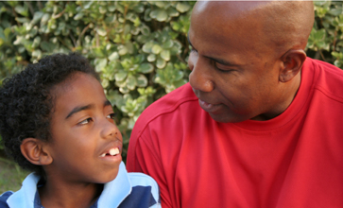
Behavioral or Health Issues: Kiwanians are often seen by a young person as an adult to trust with personal and/or sensitive information. Kiwanians should refrain from counseling youth and should instead find, or assist the young person in finding, appropriate expert assistance.

Slide 15
Message to Kiwanians from Georgia’s children:
“Thank You For Keeping Us Safe”

